Slide 1
Analysis of Temple Architecture by Isothetic Slicing
Prasad Shetkar
Supervisor: Dr. Partha Bhowmick

Slide 2
Contents
Isothetic cover detection
Orthogonal slicing of 3D object
Temple symmetry detection
Segmentation
Door detection
Conclusion

Slide 3

Isothetic cover
Digital grid
Digital object
Isothetic polygon
Grid points
Type of Points
Type 1
Type 2
Type 3
2
1
3

Slide 4
Isothetic cover
(6,6)
Grid size
4 directions
0 - up , 1 - right, 2 -down, 3-left
type 1 : decrease direction
type 3: increase direction
type 2: no change
(0,0)
(2,0)

Slide 5
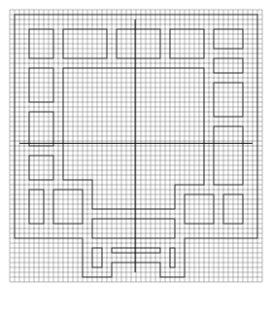
Finding holes and disconnected components

Slide 6
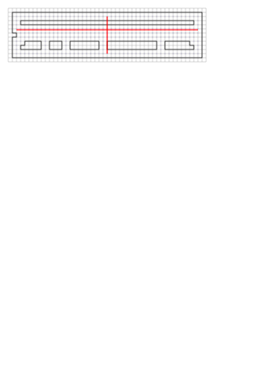
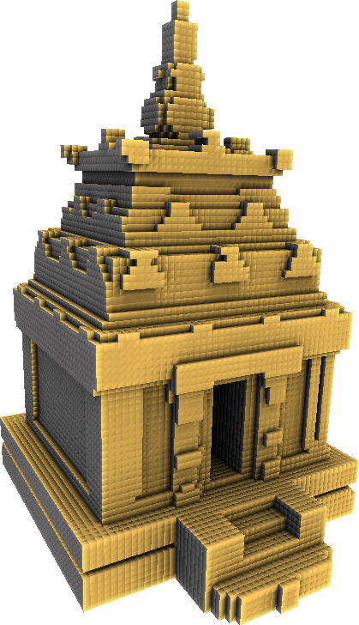
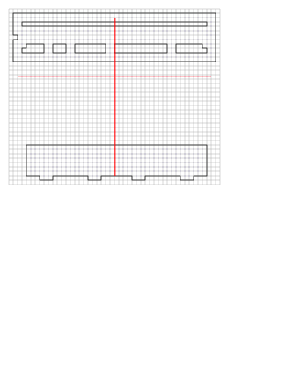
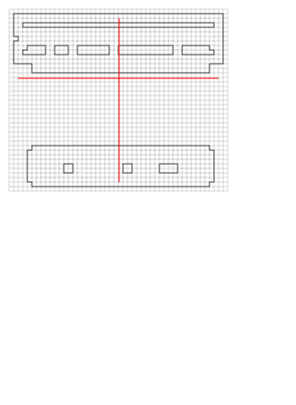
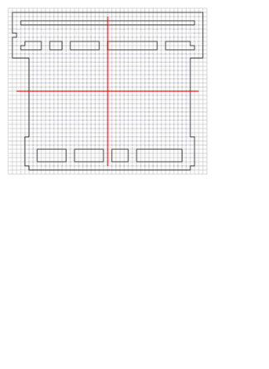
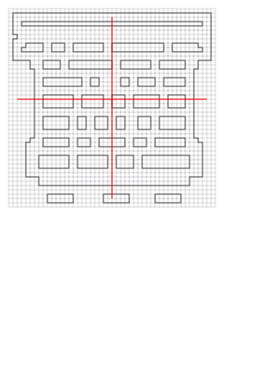
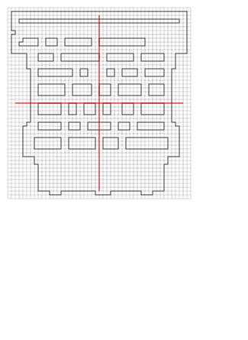
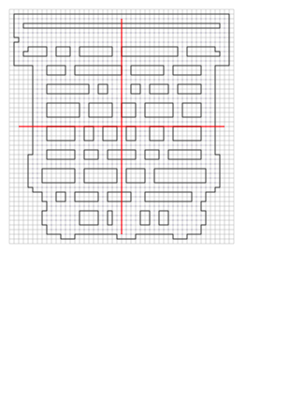
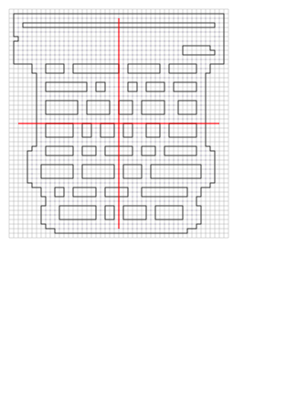
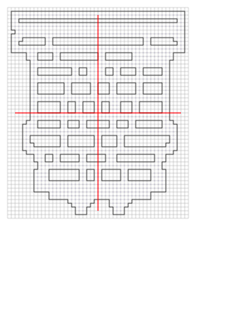
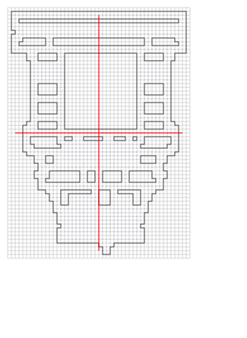
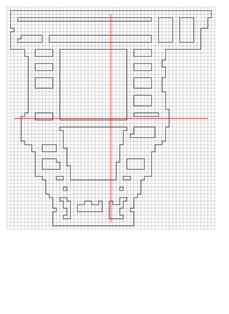
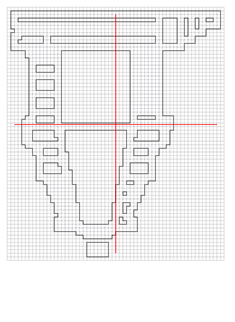
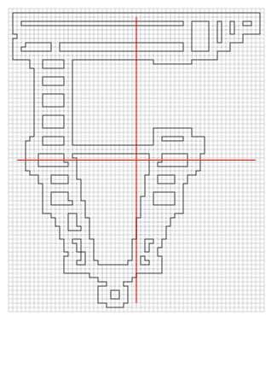
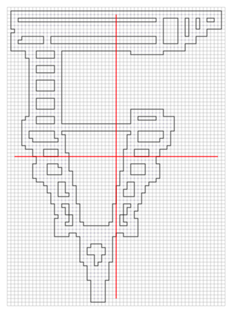
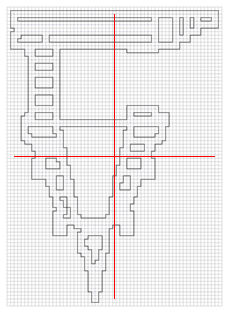
Orthogonal slicing

Slide 7
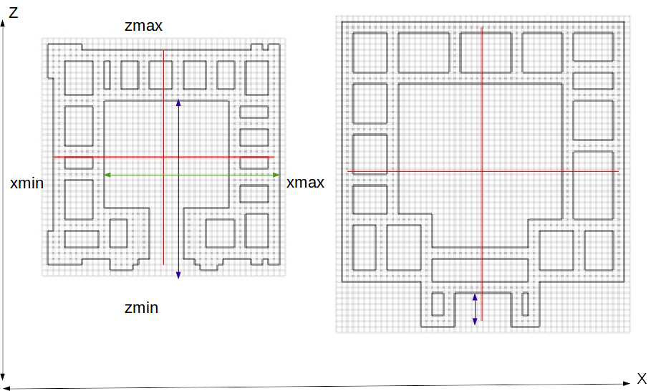
Segmentation : depth detection
xdepth
zdepth
perimeter

Slide 8
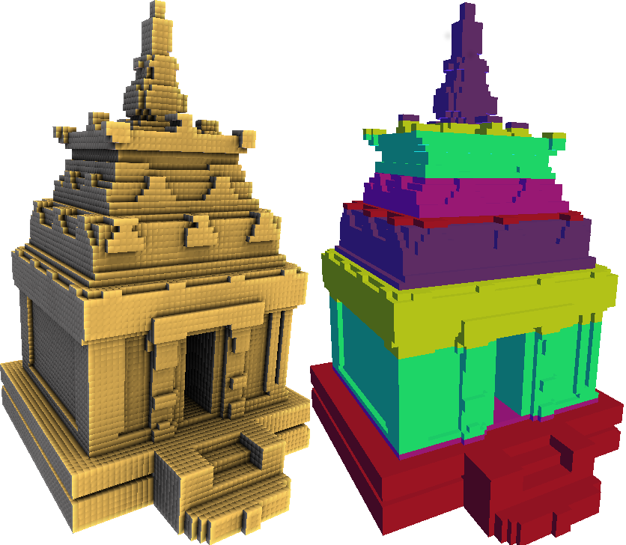
Segmentation
input: factor

Slide 9
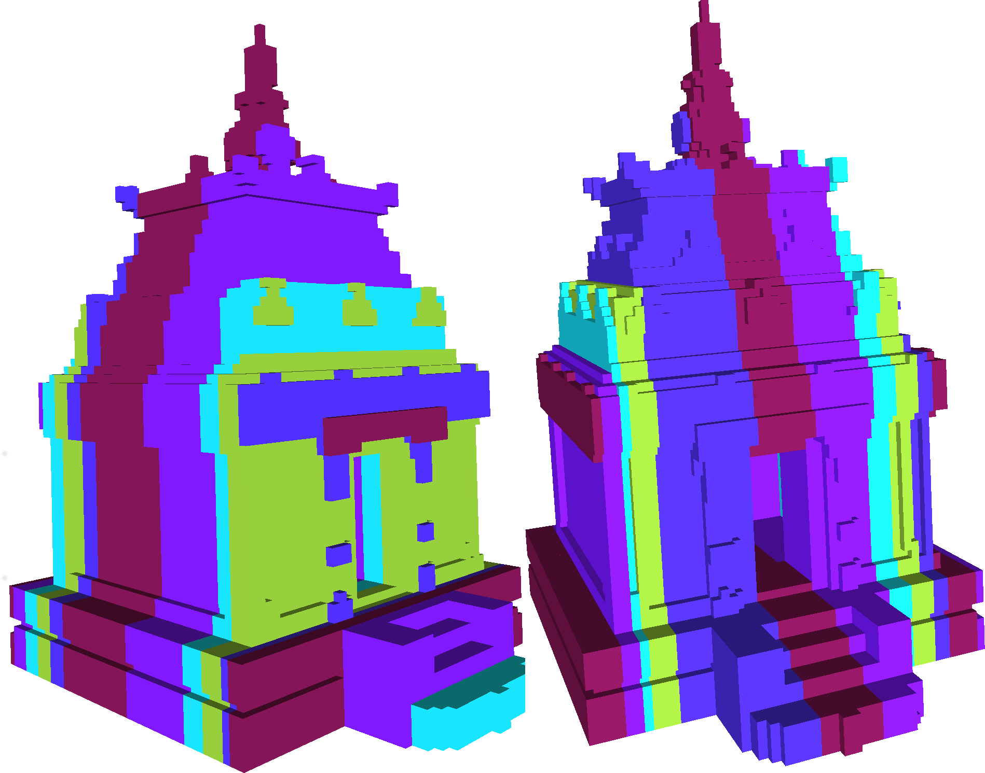
Segmentation

Slide 10
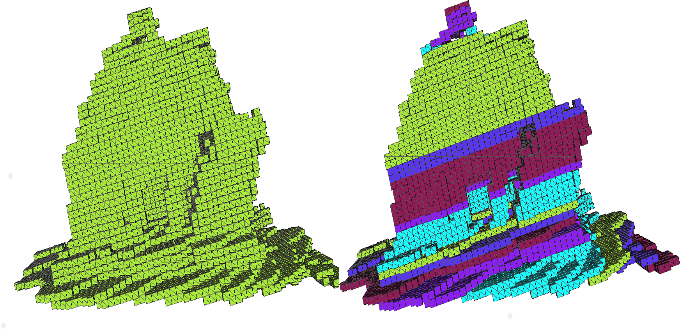
Segmentation

Slide 11
Symmetry detection

Slide 12
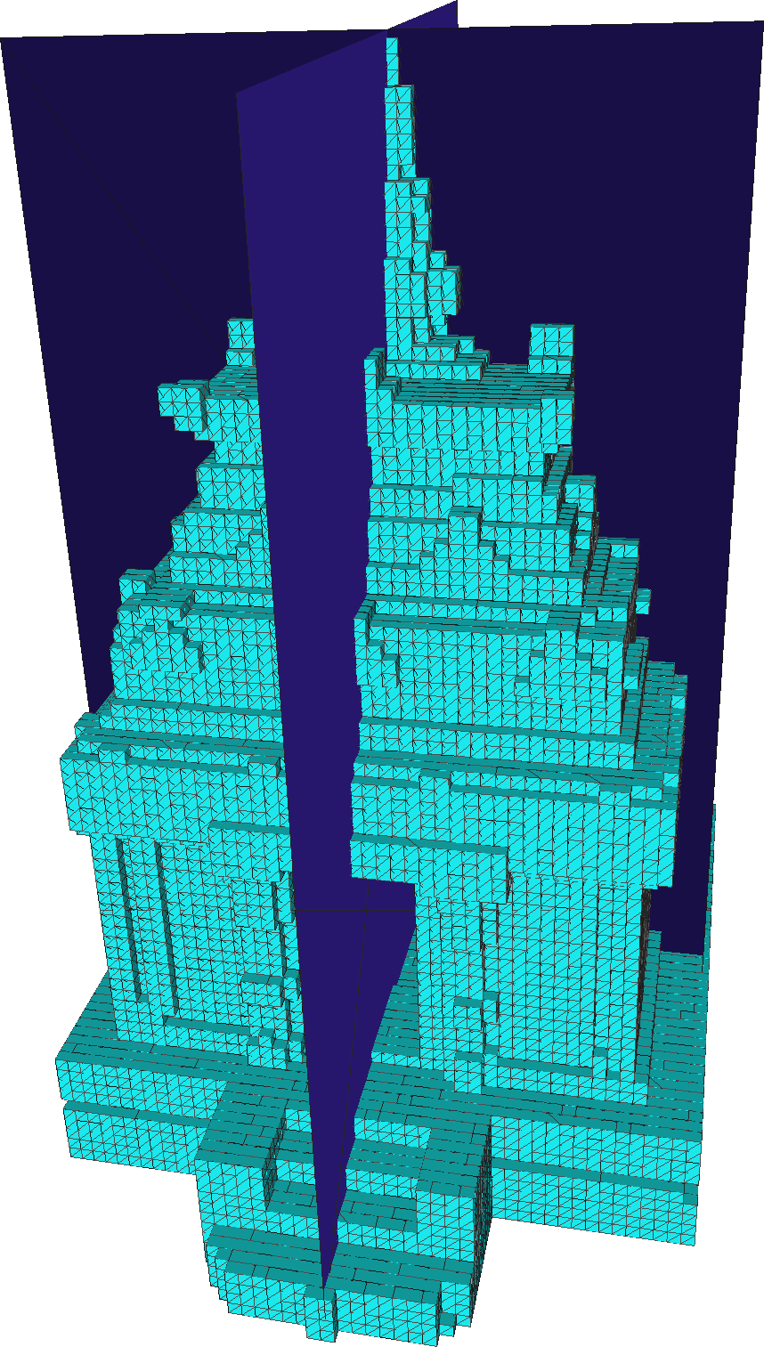
Symmetry Detection

Slide 13
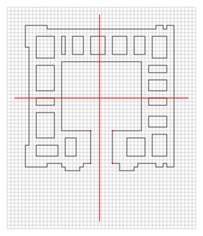
Door Detection
x

Slide 14
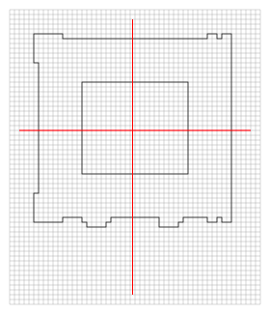
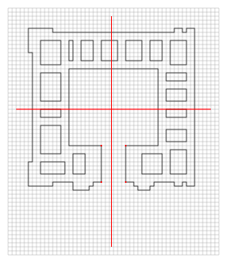
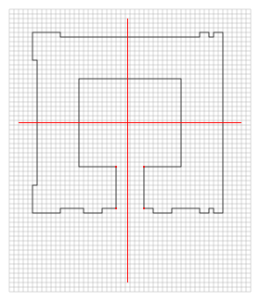
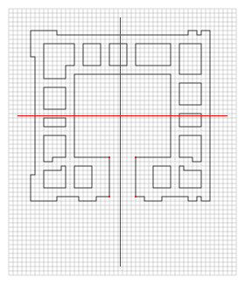
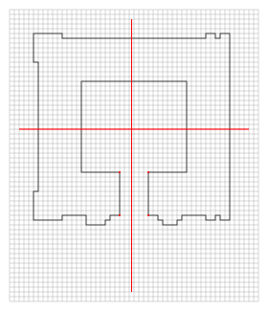
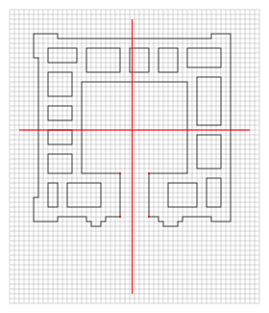
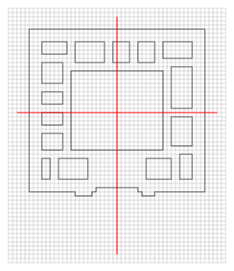
Door Detection

Slide 15
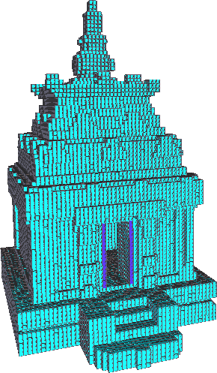
Door Detection

Slide 16
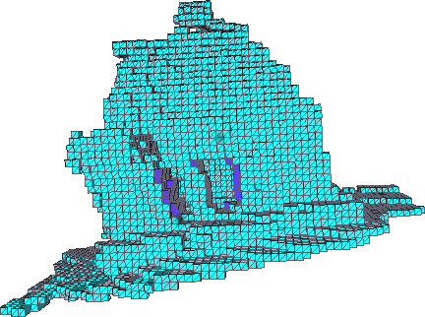
Door detection

Slide 17
Conclusion
Challenges of real world
Merging along all 3 axes.

